Slide 1
Servlets
Server side programming

Slide 2
What is a Servlet?
A servlet is a Java Programming language class
that is used to extend the capabilities of servers
that host applications accessed by means of a request-response programming model.
a web component that is deployed on the server to create a dynamic web page.

Slide 3

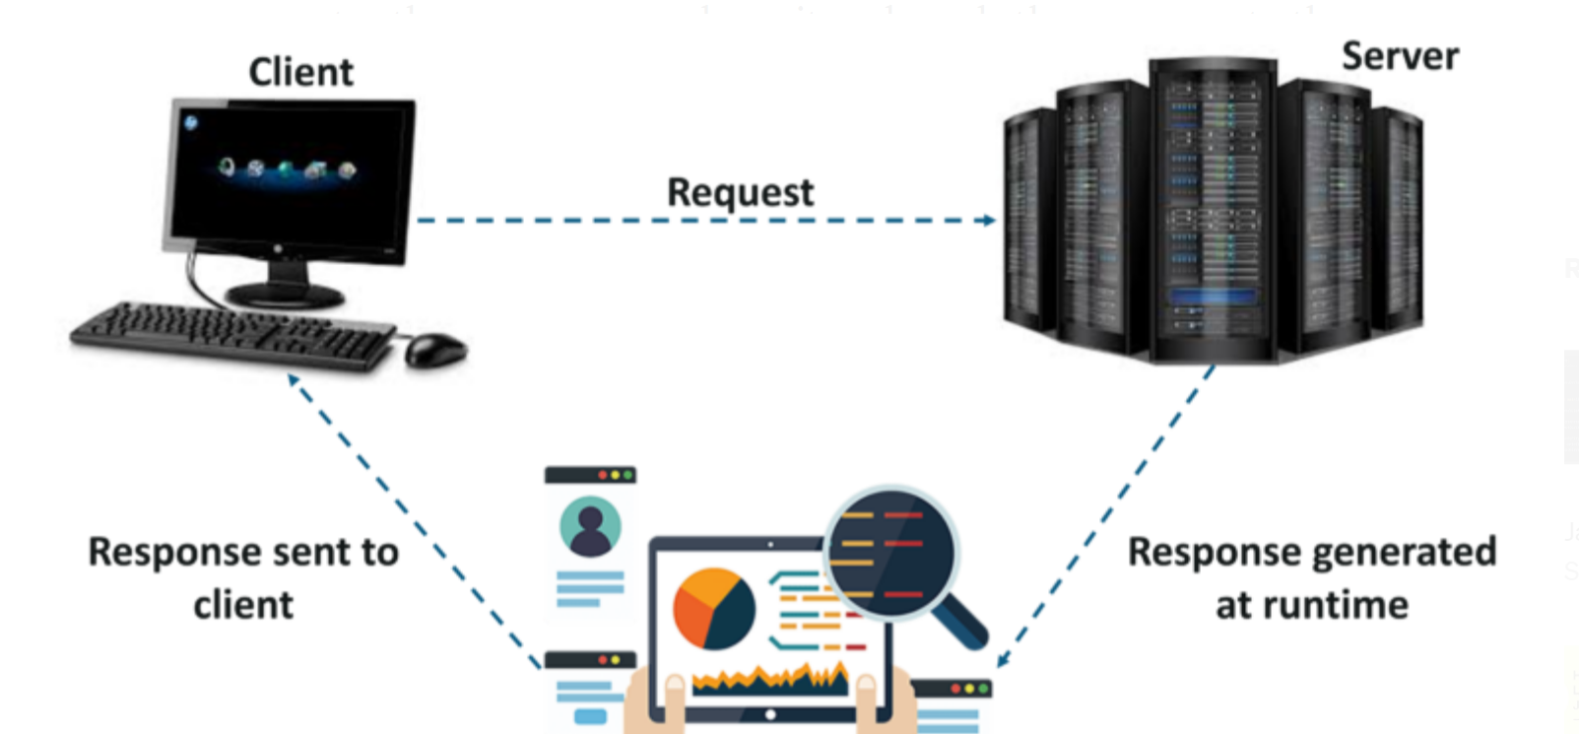
Request Response Model

Slide 4
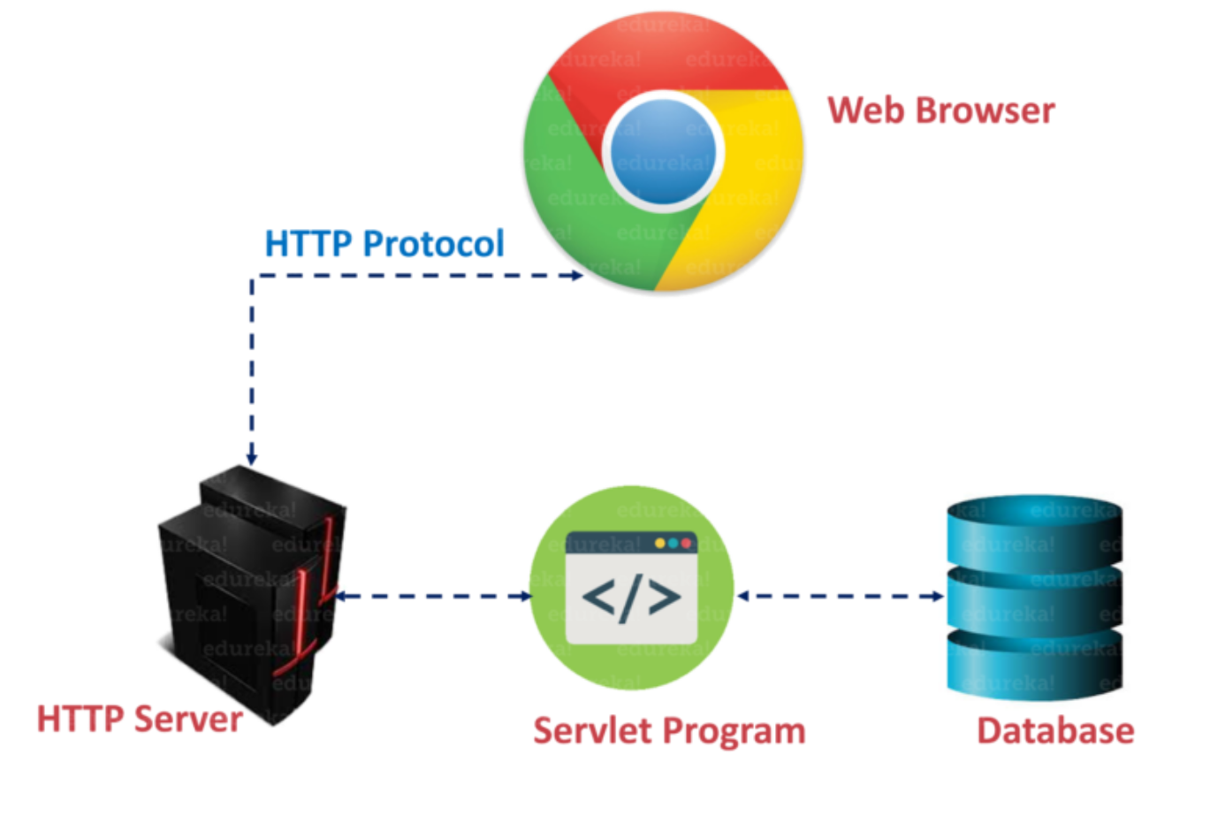
Servlet Architecture

